Slide 1
Women’s carrier in chemistry:
education, science, business.
Russian example.
Natalia P. Tarasova
Institute of Chemistry and Problems of Sustainable Development
D. Mendeleev University of Chemical Technology of Russia

Slide 2
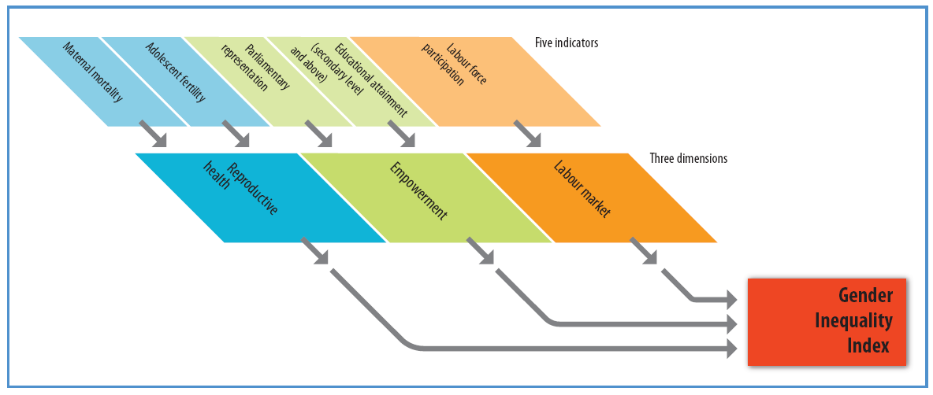
Components of the Gender Inequality Index
GII—three dimensions and five indicators
Note: The size of the boxes reflects the relative weights of the indicators and dimensions
Source: HDRO

Slide 3
Women represent about 7% of CEO registered in the Russian Chemists Union.
According to the statistics of the Russian Labour Union of Chemical Industry (year 2011) :
413 industrial enterprises
Female employers - 43%
615 accidents - 27% of women among injured persons

Slide 4
Women among chemistry students
Vocational training- 55%
Higher chemistry education (undergraduate and graduate levels)- 49%
Post - graduate level -47%
Doctorate level - 33%
8 specialized chemistry universities in Russia

Slide 5
Women in the RAS
Full members
449 : women ~ 2%
Corresponding members
719 : women ~ 4%
Branch of chemistry and
material sciences
168: women~3% (1 + 4)

Slide 6
Women at D. Mendeleev University
Faculty members: 612 , ~ 50% are women
Age distribution of female faculty members
(n=305; year 2011 )

Slide 7
Women’s carrier in chemistry
Pilot sociological studies, April-May 2011

Slide 8
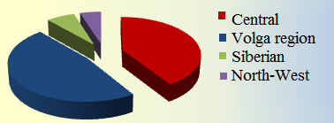
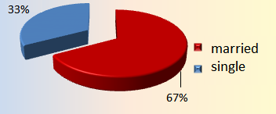
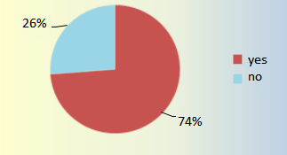
Socio-demographic characteristics
Age
Residence (federal districts)
Marital status
Children

Slide 9
Areas of professional activities in chemistry

Slide 10
Carrier and successfulness
«A successful woman is successful in all spheres»
Do you consider yourself to be a successful woman?

Slide 11
Key factors of success
1 rank
2 rank
3 rank

Slide 12
Key factors of success
EDUCATION
INDUSTRY
BUSINESS
SCIENCE
PROFESSIONALISM
1 rank
ASSERTIVENESS
PURPOSEFULNESS
2 rank
KEEN INTELLIGENCE
PURPOSEFULNESS
SELF-ORGANIZATION
ASSERTIVENESS
3 rank

Slide 13
PROFILE OF HIGHER EDUCATION

Slide 14
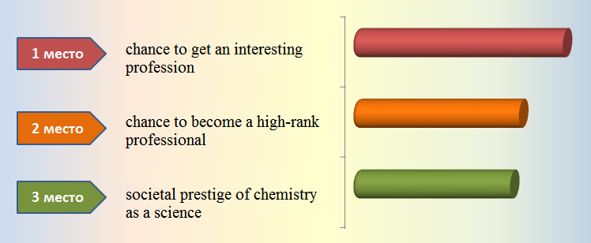
MOTIVATION FOR HIGHER EDUCATION

Slide 15
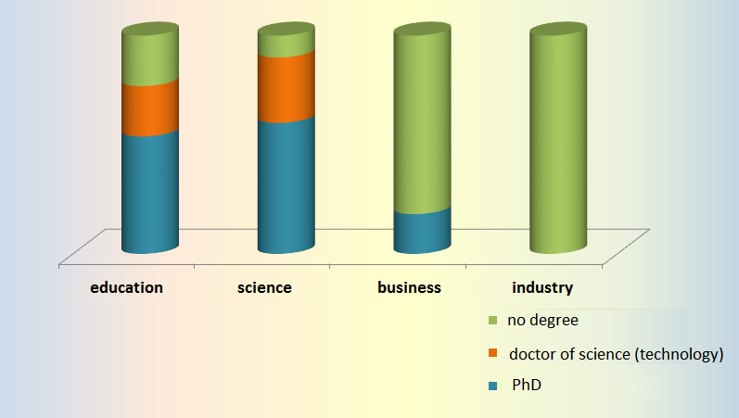
ACADEMIC DEGREE

Slide 16
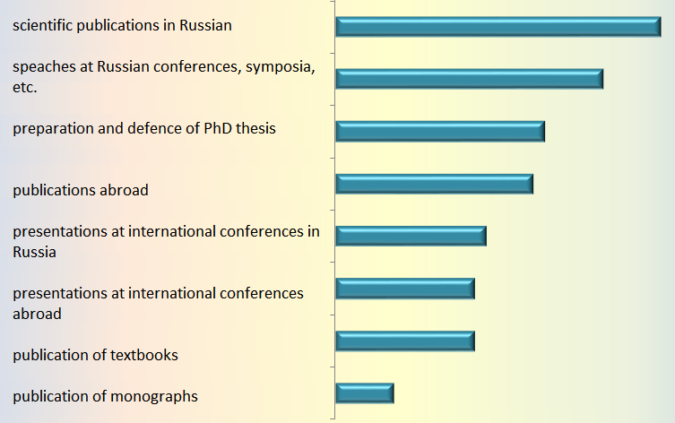
SCIENTIFIC ACTIVITIES

Slide 17
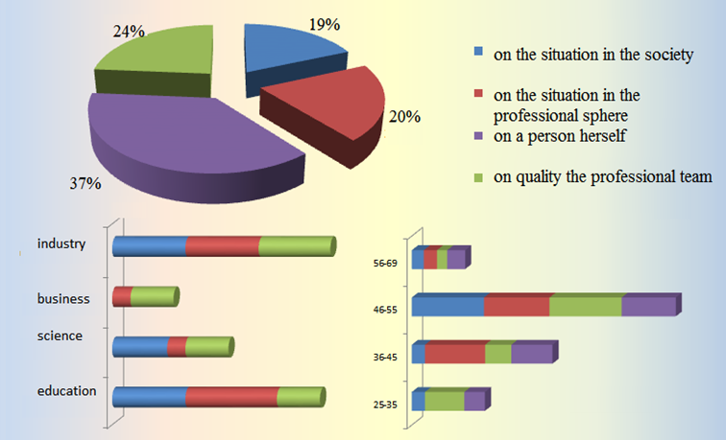
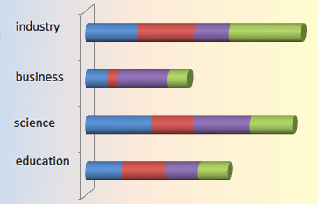
FACTORS AFFECTING THE SUCCESS
What does the successful carrier depend on at present?

Slide 18
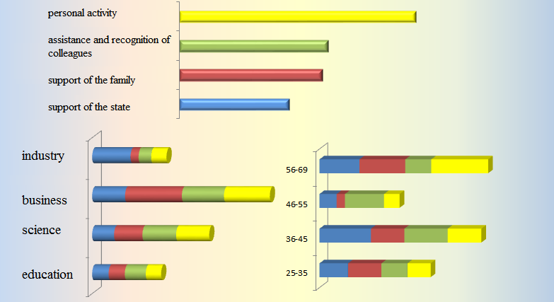
FACTORS AFFECTING THE SUCCESS
In the modern society, what does give a possibility for a woman to score a carrier success?

Slide 19
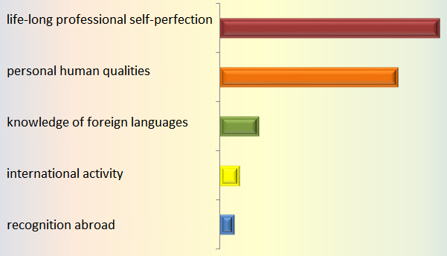
PERSONAL CARRIER SUCCESS
Chemistry business-ladies rank “personal human qualities” first

Slide 20
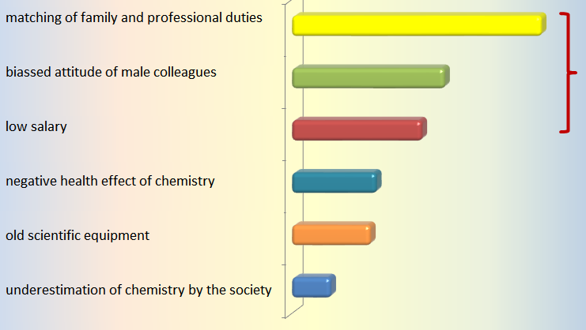
“OCCUPATIONAL” PROBLEMS OF FEMALE CHEMISTS

Slide 21
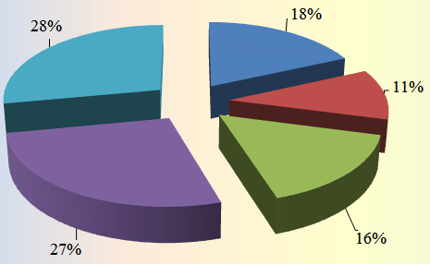
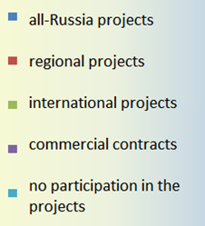
INTERNATIONAL ACTIVITIES PARTICIPATION IN THE PROJECTS

Slide 22
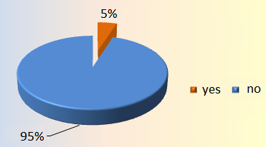
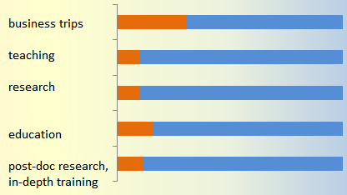
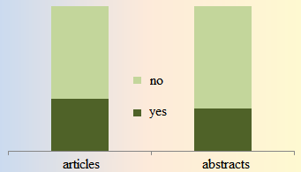
Международная деятельность
INTERNATIONAL ACTIVITIES
Are you a member of international professional associations?
PARTICIPATION DURING LAST 5 YEARS
Do you have scientific publications abroad?

Slide 23
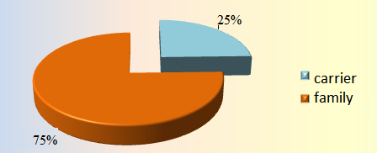
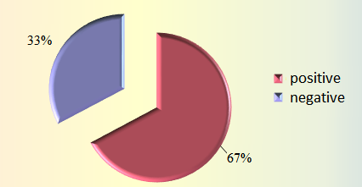
CARRIER AND FAMILY
WHAT IS OF GREATER IMPORTANCE FOR YOU AT PRESENT?
HOW DOES THE CARRIER MOTIVATION AFFECT THE FAMILY SITUATION?

Slide 24
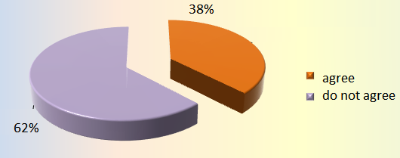
CARRIER AND FAMILY
The key role a woman ought to play – is her traditional predestination- family, husband, children.

Slide 25
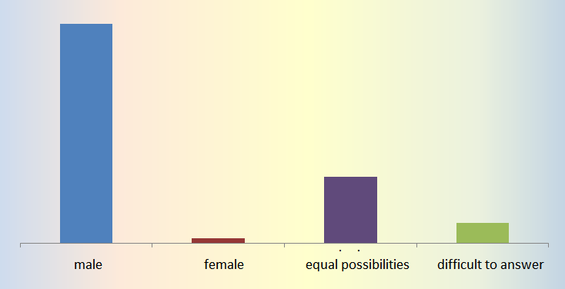
Chances for the professional promotion and carrier in the modern Russian society

Slide 26
Family
Values
Health
1
Peace and order in the country
2
3

Slide 27
Values
(depending on the professional area in chemistry)
Education
Science
Business
Industry
Peace and order in the country
1 rank
Health
Family
Family
Peace and order in the country
2 rank
Family
Health
Health
Self-perfection
Order in the country
3 rank
Health
Family

Slide 28
Easy Problems
Action #1
Actual
Desired
Better ------->
Action #2
Now
Future
Next Evaluation

Slide 29
Difficult Problems
Action #1
Action #2
Desired
Better ------->
Actual
Now
Future
Next Evaluation

Slide 30
Difficult Problems Become Easy with Greater Time Horizon
Action #1
Desired
Better ------->
Actual
Action #2
Now
Future
Next Evaluation

Slide 31
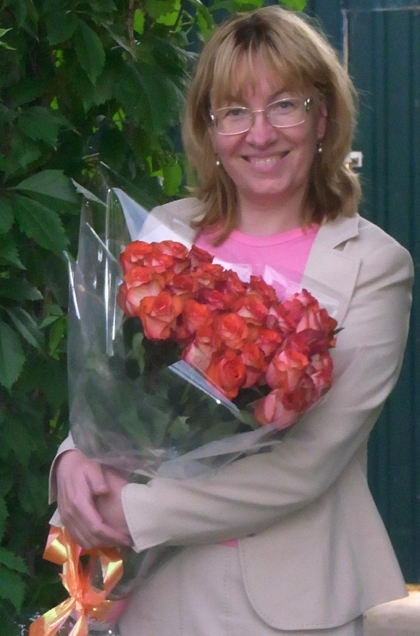
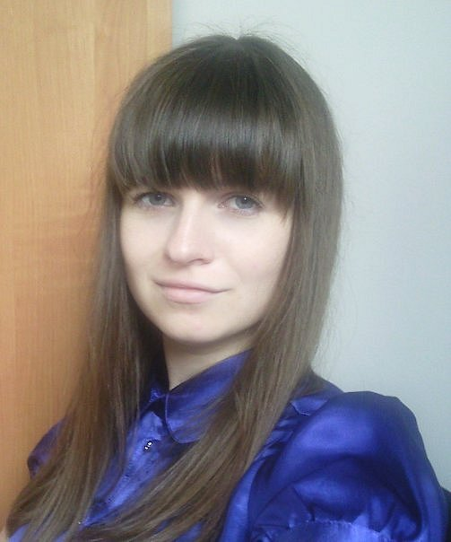
My co-authors
Marina V. Rybakova, Doctor of Sociology, professor, Department of Sociology, Institute of Chemistry and Problems of Sustainable Development, D.Mendeleev University of Chemical Technology of Russia
Margarita Yu.Tschukina, graduate of the Department of Sociology, Institute of Chemistry and Problems of Sustainable Development,
D. Mendeleev University of Chemical Technology of Russia

Slide 32
Acknowledgements
Dr. Igor G. Kukushkin, executive director of
The Russian Union of Chemists
Mrs. Larissa V. Leont’eva, head of the personnal department, D. Mendeleev University of Chemical Technology of Russia

